Slide 1


MySQL Tutorial
MySQL Architecture
Common Tools
Examples
António Amorim, Carlos Jesus. CU1 - DBWorkshop 9-10 /Feb/09

Slide 2
MySQL Overview
What is MySQL?
MySQL, the most popular Open Source SQL database management system, is developed, distributed, and supported by MySQL AB. MySQL AB is a commercial company, founded in 1995 by the MySQL developers. It is a second generation Open Source company that unites Open Source values and methodology with a successful business model.
The MySQL® software delivers a very fast, multi-threaded, multi-user, and robust SQL (Structured Query Language) database server. MySQL Server is intended for mission-critical, heavy-load production systems as well as for embedding into mass-deployed software. MySQL is a registered trademark of MySQL AB.
The MySQL software is Dual Licensed. Users can choose to use the MySQL software as an Open Source product under the terms of the GNU General Public License or can purchase a standard commercial license from MySQL AB.
The company name was given after co-founder Monty Widenius's daughter, My, the SQL is “Structured Query Language.”, AB is Sweedish for limited partnership.
wits
António Amorim, Carlos Jesus. CU1 - DBWorkshop 9-10 /Feb/09

Slide 3
MySQL Overview
What does it do?
MySQL is a database management system.
  A database is a structured collection of data. To add, access, and process data stored in a computer database, you need a database management system such as MySQL Server.
MySQL is a relational database management system.
  A relational database stores data in separate tables rather than putting all the data in one big storeroom. This adds speed and flexibility. The SQL part of “MySQL” stands for “Structured Query Language.”
MySQL software is Open Source.
Open Source means that it is possible for anyone to use and modify the software. Anybody can download the MySQL software from the Internet and use it without paying anything. If you wish, you may study the source code and change it to suit your needs. If you want to redistribute altered versions MySQL, other licences are available
MySQL Server works in client/server or embedded systems.
  The MySQL Database Software is a client/server system that consists of a multi-threaded SQL server that supports different backends, several different client programs and libraries, administrative tools, and a wide range of application programming interfaces (APIs).
A large amount of contributed MySQL software is available.
  MySQL is a widely supported database, and very likely that most of your applications supports it.
wits
António Amorim, Carlos Jesus. CU1 - DBWorkshop 9-10 /Feb/09

Slide 4
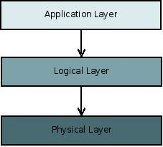
MySQL Architecture
Three layer model:
The application layer contains common network services for connection handling, authentication and security. This layer is where different clients interact with MySQL these clients can written in different API's:.NET, Java, C, C++, PHP, Python, Ruby, Tcl, Eiffel, etc...
The Logical Layer is where the MySQL intelligence resides, it includes functionality for query parsing, analysis, caching and all built-in functions (math, date...). This layer also provides functionality common across the storage engines.
The Physical Layer is responsible for storing and retrieving all data stored in “MySQL”. Associated with this layer are the storage engines, which MySQL interacts with very basic standard API's. Each storage engine has it strengths and weakness, some of this engines are MyISAM, InnoDB, CSV, NDB Cluster, Falcon, etc...
wits
António Amorim, Carlos Jesus. CU1 - DBWorkshop 9-10 /Feb/09

Slide 5
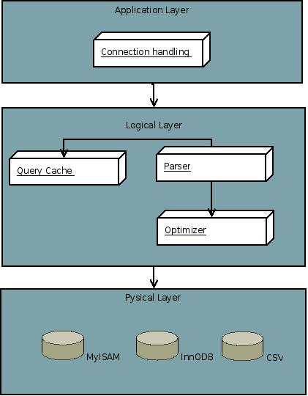
MySQL Architecture
Some internal components:
Each client connection gets its own thread within the server process.
When clients (applications) connect to the MySQL server, the server needs to authenticate them.
Before even parsing the query, though, the server consults the query cache, which only stores SELECT statements, along with their result sets.
The storage engine does affect how the server optimizes query.
António Amorim, Carlos Jesus. CU1 - DBWorkshop 9-10 /Feb/09

Slide 6
MySQL Architecture
Transactional properties (ACID):
MySQL Innodb storage engine fully supports transactions, a transaction can be viewed as a block of instructions that act are applied coherently to the database, in turn this means ACID standard compliance:
Atomicity : Each transaction block is treated as a single instruction, all of the block must succeed or none.
Consistency : Only valid data is written to the database, and the resulting state is valid.
Isolation : While performing operations in a transaction block, other transactions don't see our changes.
Durability : If the transaction returns a successful state it is persisted to the database.
António Amorim, Carlos Jesus. CU1 - DBWorkshop 9-10 /Feb/09

Slide 7
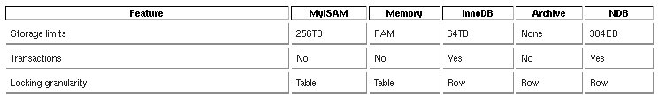
MySQL Architecture
Storage engines:
MySQL supports several storage engines that act as handlers for different table types. MySQL storage engines include both those that handle transaction-safe tables and those that handle non-transaction-safe tables.
António Amorim, Carlos Jesus. CU1 - DBWorkshop 9-10 /Feb/09

Slide 8
MySQL Installation
Windows Installation wizard: http://dev.mysql.com/downloads/mysql/5.1.html#win32
Linux:
Debian Based: apt-get install mysql-server-5.0
RPM based: rpm -ivh MySQL-server-*5.1.31-0.rhel3.i386.rpm
YUM Based: yum install mysql-sever
Gentoo Based: emerge mysql
Macintosh:
http://dev.mysql.com/downloads/mysql/5.1.html#macosx
All in One Packages
MAMP – Macintosh Apache MySQL and PHP
http://www.mamp.info/en/index.php
WAMP – Windows Apache MySQL and PHP
http://www.wampserver.com/en/
António Amorim, Carlos Jesus. CU1 - DBWorkshop 9-10 /Feb/09

Slide 9
MySQL Overview
MySQL Files:
In Linux the configuration file is typically located at /etc/mysql/my.cnf, but may vary for the different Linux flavours, this also applies to the database files them selves which are located in the /var/lib/MySQL.
Regardless of the storage engine, every MySQL table you create is represented, on disk, by a .frm file, which describes the table’s format (i.e. the table definition). The file bears the same name as the table, with a .frm extension. The .frm format is the same on all platforms but in the description of the .frm format that follows, the examples come from tables created under the Linux operating system.
/var/lib/mysql/db.frm #Table definition
/var/lib/mysql/db.MYD #MyISAM data file
/var/lib/mysql/db.MYI #MyISAM Index file
/var/lib/mysql/ibdata1 #Innodb data file
wits
António Amorim, Carlos Jesus. CU1 - DBWorkshop 9-10 /Feb/09

Slide 10
MySQL
Command Line tools
On Linux the a user can interact with MySQL using the command line, in this interaction a user can create, update, delete and modify a MySQL database using the following command line tools
mysql: general database and table interaction:
mysql -u username -ppassword -h localhost db_name
mysqldump: database backup
mysqldump db_name > outputfile
mysqlbinlog: binary log processing
mysqlbinlog logfile_1 logfile_2 ... logfile_n > out.sql
mysqlbinlog logfile_1 logfile_2 ... logfile_n | mysql
mysql_install_db: database restore
mysql_install_db
António Amorim, Carlos Jesus. CU1 - DBWorkshop 9-10 /Feb/09

Slide 11
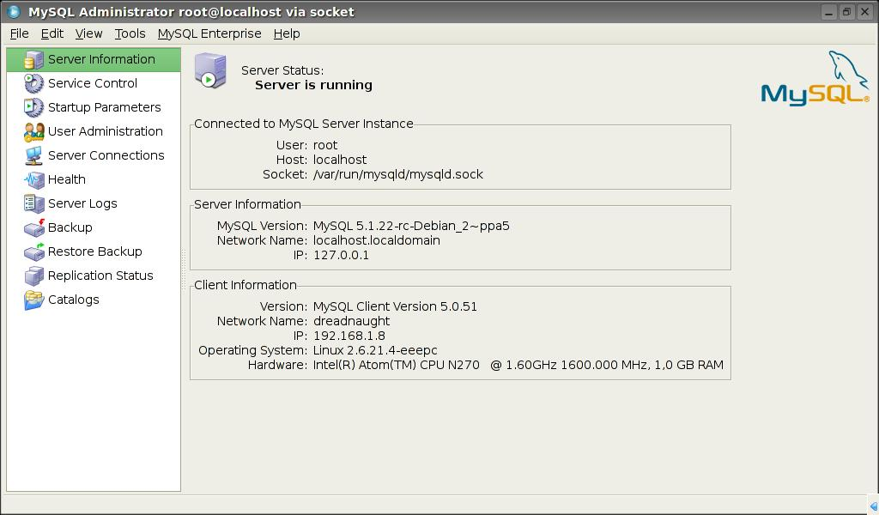
MySQL Graphical tools
MySQL administrator
Multi plataform, administration tool allows to:
Manage users
Manage databases and tables
Perform maintenance tasks
See server status
António Amorim, Carlos Jesus. CU1 - DBWorkshop 9-10 /Feb/09

Slide 12
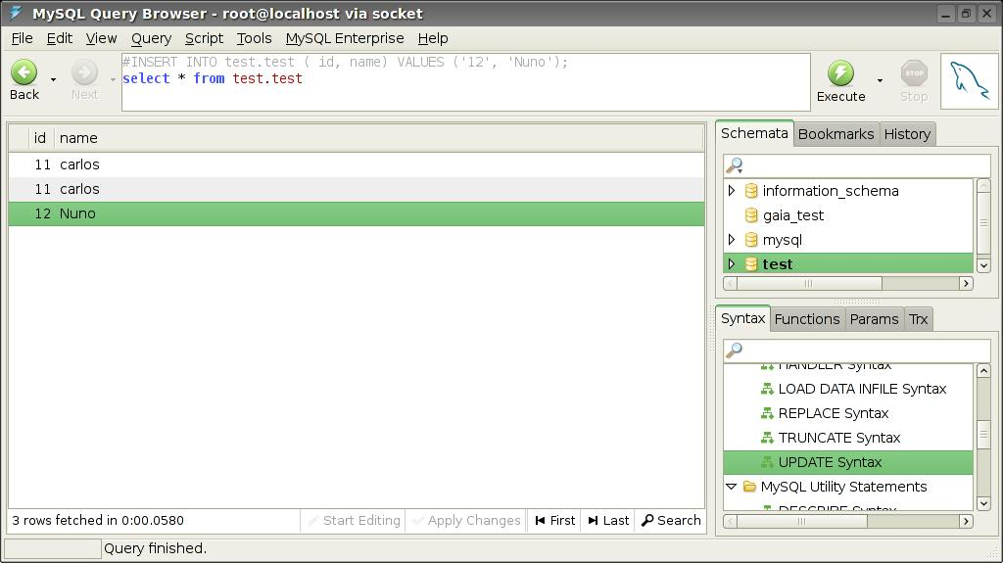
MySQL Graphical tools
MySQL query browser
MySQL query browser is a simple query tool used to interact with a MySQl database.
António Amorim, Carlos Jesus. CU1 - DBWorkshop 9-10 /Feb/09

Slide 13
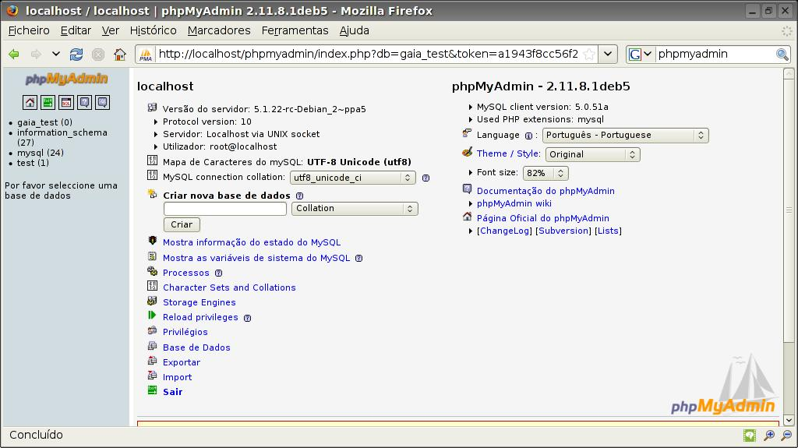
MySQL Graphical tools
phpmyadim
Phpmyadmin is a browser tool developed in php, that allows you to manage a mysql database.
António Amorim, Carlos Jesus. CU1 - DBWorkshop 9-10 /Feb/09

Slide 14
MySQL and Gaia
DbBenchmark
DbBenchmark is a simple java application that makes use of GaiaTools (currently outdated), and performs a series of standard tests.
Class mapping:
mdb.properties
test control:
dbbenchmark.properties.mysql_elem
gaia.cu1.tools.db.username=username
gaia.cu1.tools.db.password=password
gaia.cu1.tools.db.driver=com.mysql.jdbc.Driver
gaia.cu1.tools.db.url=jdbc:mysql://localhost:3306/gaia_test?rewriteBatchedStatements=true
Running the tests:
ant mysql_elem_random
António Amorim, Carlos Jesus. CU1 - DBWorkshop 9-10 /Feb/09

Slide 15
MySQL and Gaia
MDBIngestorExtractor
MDBIngestorExtractor is a application that allows the extraction and ingestion “gbin” files, which are
Class mapping:
conf/mdb.properties
MDB Extractor Ingestor properties:
conf/ingestor.properties
conf/extractor.properties
gaia.cu1.tools.db.username=username
gaia.cu1.tools.db.password=password
gaia.cu1.tools.db.url=jdbc:mysql://localhost:3306/test
gaia.cu1.tools.db.driver=com.mysql.jdbc.Driver
Lauching the extactor/ingestor:
bash ingest.sh
bash extract.sh
António Amorim, Carlos Jesus. CU1 - DBWorkshop 9-10 /Feb/09

Slide 16
MySQL queries
Create a database:
create database database_name;
Display databases:
show databases;
Selecting a database
use database_name
Display tables:
show tables
Create a table:
create table create table person
(id int, person varchar (32) )
engine=engine_name
Deleting a table:
Drop table table_name
Insert a value in a table:
Insert into table_name.db_name
(field1 , field 2...) Values (v1, v2, ...), (v1',v2');
View data all data in a table:
select * from table name where cond = value
Select data from two different tables:
Select field1, field2 from tbl1, tbl2 where
field3= field4;
Sow create table statement:
show create table tbl_name
Show database variables:
show variables;
António Amorim, Carlos Jesus. CU1 - DBWorkshop 9-10 /Feb/09

Slide 17
Q&A
Books:
OreIlly High Performance MySQL Second Edition Jun 2008
OReilly MySQL in a Nutshell 2nd Edition
More on MySQL-cluster and other studies:
SIM Studies at the GAIA WIKI
The technical note:
GAIA-C1-TN-SIM-CDJ-001-1.pdf
GAIA-C1-TN-SIM-AAB-001-01.pdf
António Amorim, Carlos Jesus. CU1 - First Database Testing Meeting, 20/Nov/08

Slide 18
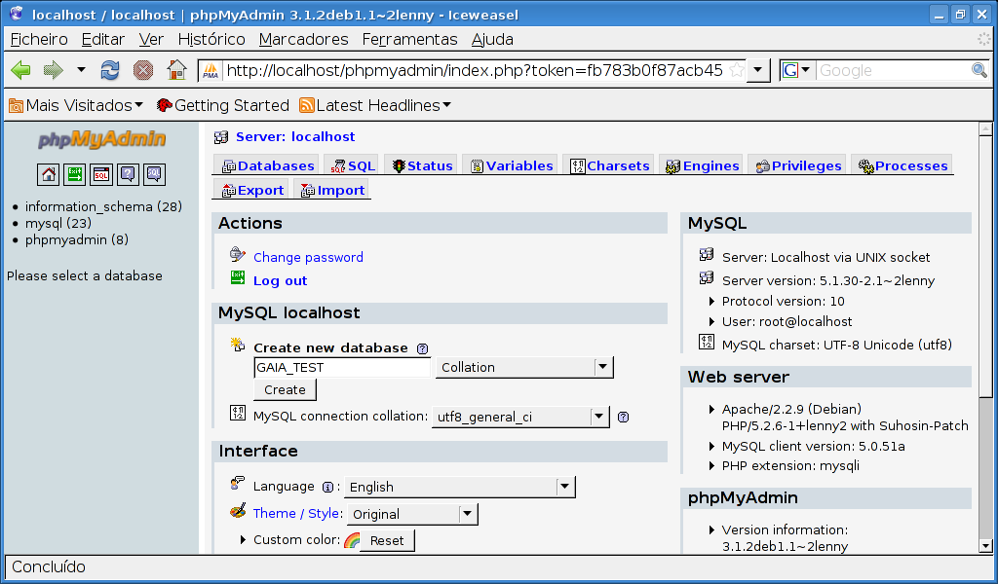
MySQL Graphical tools
phpmysqladmin and foreign keys
António Amorim, Carlos Jesus. CU1 - DBWorkshop 9-10 /Feb/09

Slide 19
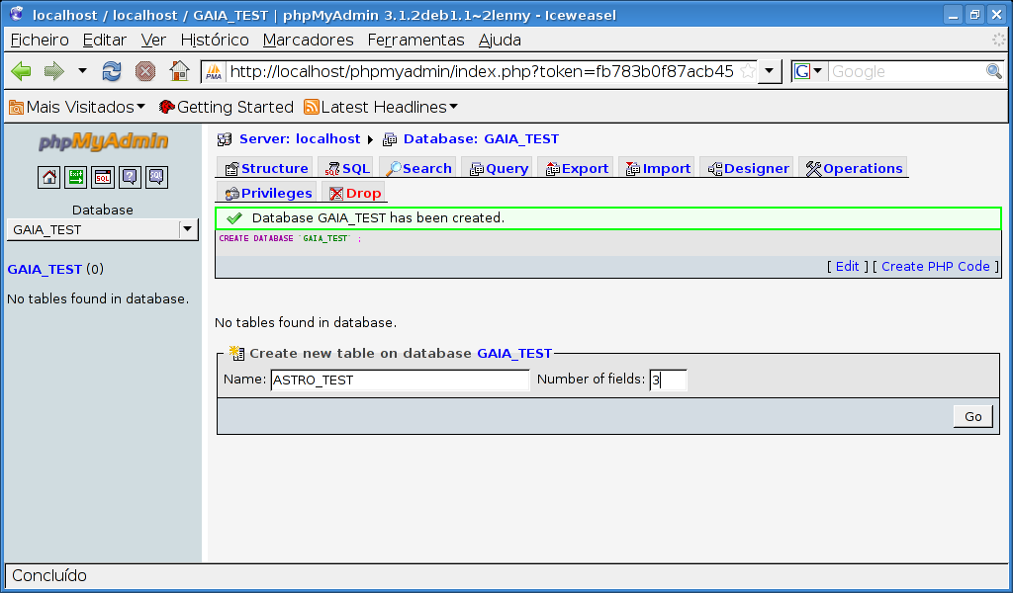
MySQL Graphical tools
phpmysqladmin and foreign keys
António Amorim, Carlos Jesus. CU1 - DBWorkshop 9-10 /Feb/09

Slide 20
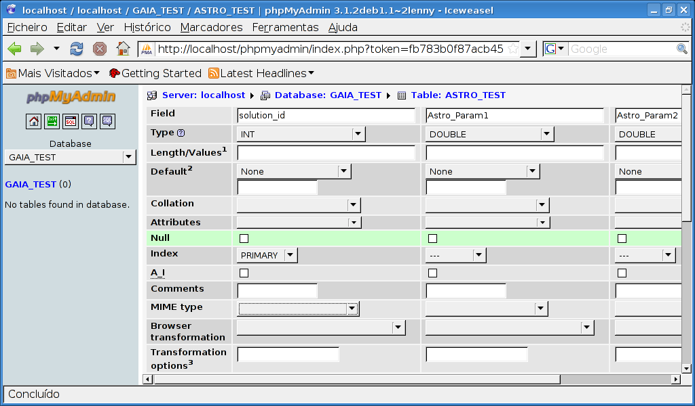
MySQL Graphical tools
Phpmyadmin and foreign keys
António Amorim, Carlos Jesus. CU1 - DBWorkshop 9-10 /Feb/09

Slide 21
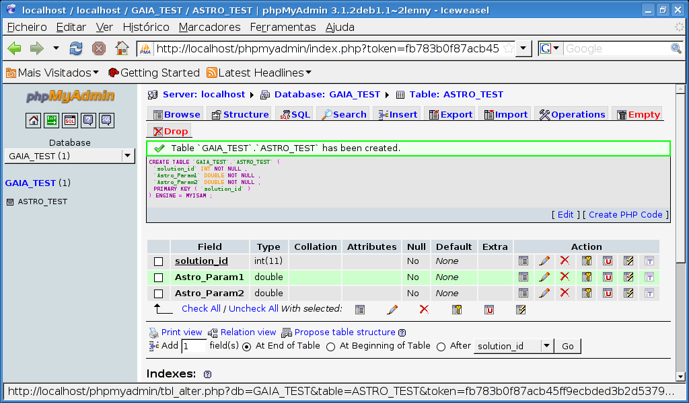
MySQL Graphical tools
phpmyadmin and foreign keys
António Amorim, Carlos Jesus. CU1 - DBWorkshop 9-10 /Feb/09

Slide 22
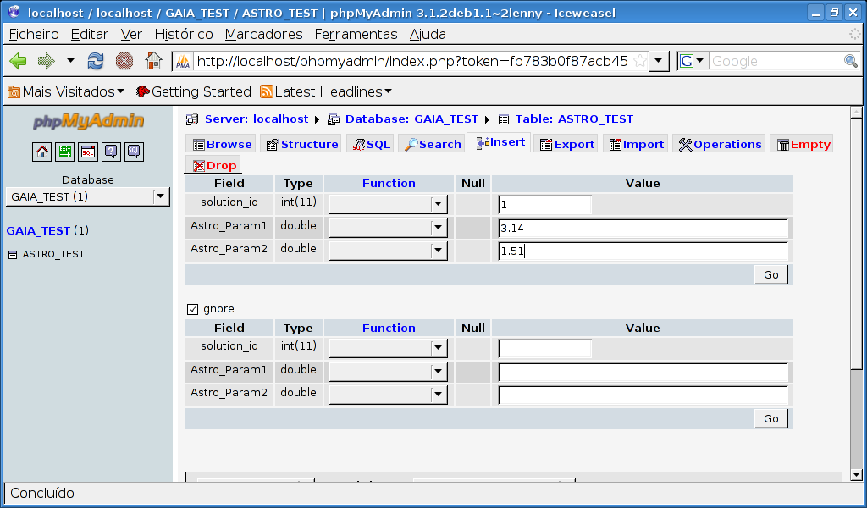
MySQL Graphical tools
phpmyadmin and foreign keys
António Amorim, Carlos Jesus. CU1 - DBWorkshop 9-10 /Feb/09

Slide 23
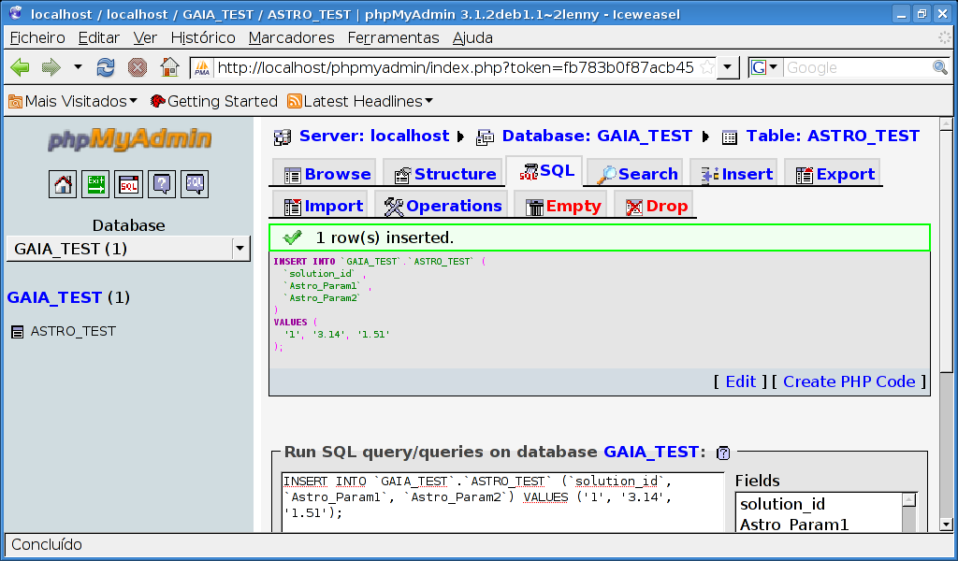
MySQL Graphical tools
phpmyadmin and foreign keys
António Amorim, Carlos Jesus. CU1 - DBWorkshop 9-10 /Feb/09

Slide 24
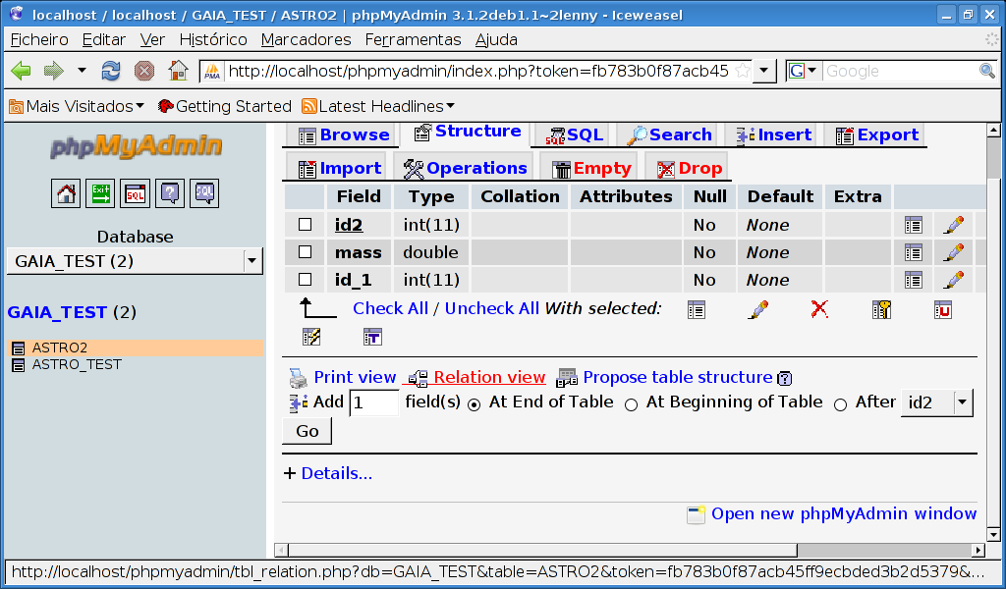
MySQL Graphical tools
phpmyadmin and foreign keys
António Amorim, Carlos Jesus. CU1 - DBWorkshop 9-10 /Feb/09

Slide 25
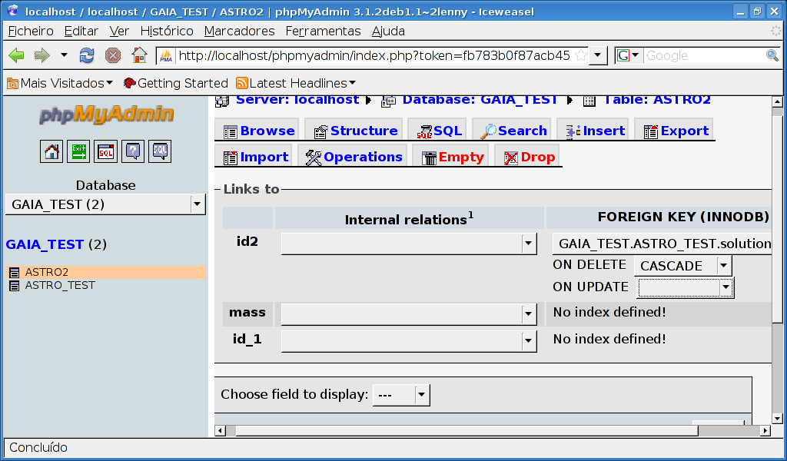
MySQL Graphical tools
phpmyadmin and foreign keys
António Amorim, Carlos Jesus. CU1 - DBWorkshop 9-10 /Feb/09

Slide 26
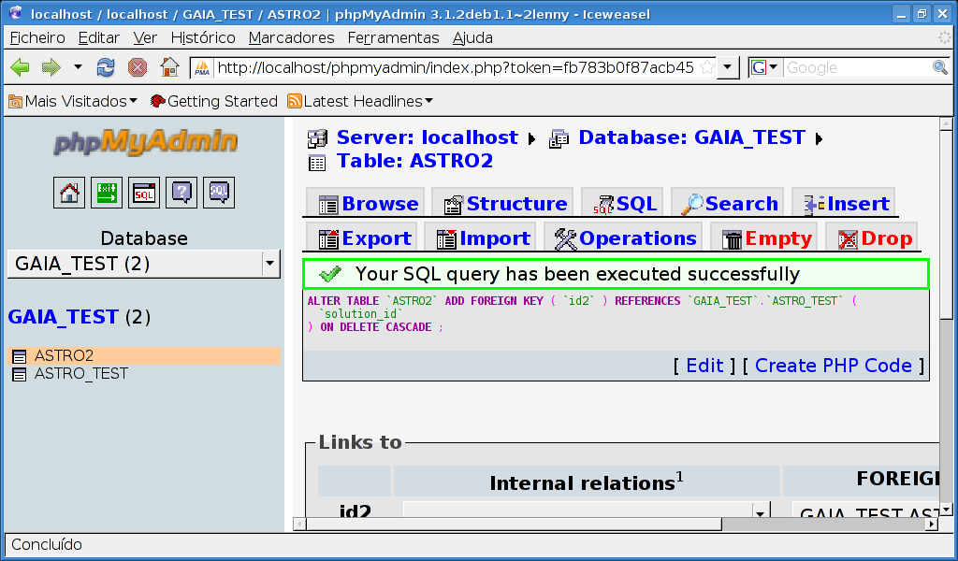
MySQL Graphical tools
phpmyadmin and foreign keys
António Amorim, Carlos Jesus. CU1 - DBWorkshop 9-10 /Feb/09

Slide 27
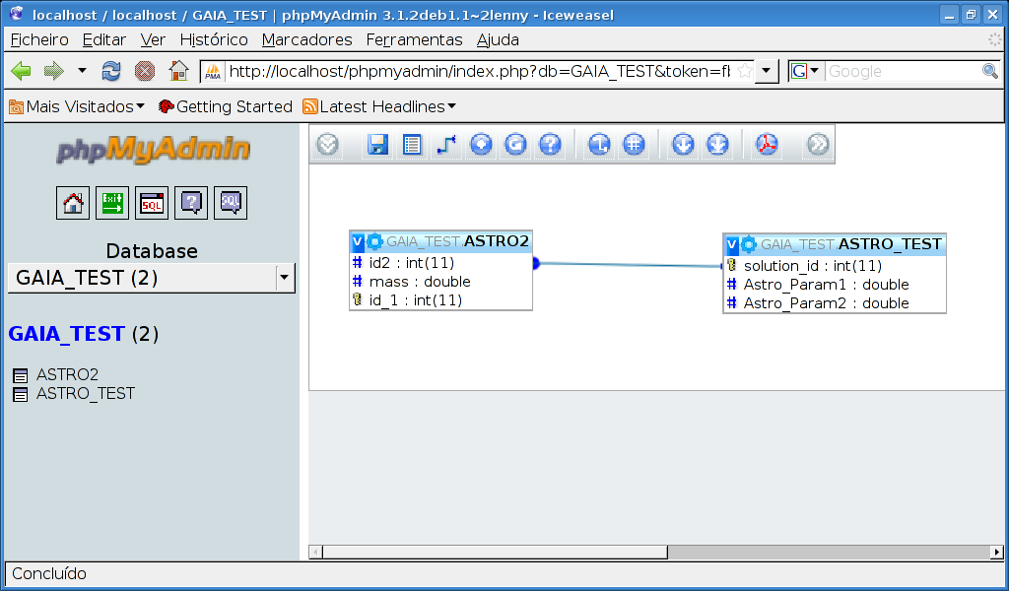
MySQL Graphical tools
phpmyadmin and foreign keys
António Amorim, Carlos Jesus. CU1 - DBWorkshop 9-10 /Feb/09

